Slide 1


TRƯỜNG ĐẠI HỌC CONG NGHỆ TP.HCM-HUTECH
Web Programming
FINAL EXAM AS PROJECT
20DTHQA1
TRẦN NGUYỄN BẢO TOÀN - 2011061154
ĐỖ HOÀNG CÔNG DANH - 2011064187

Slide 2

Set up

Slide 3
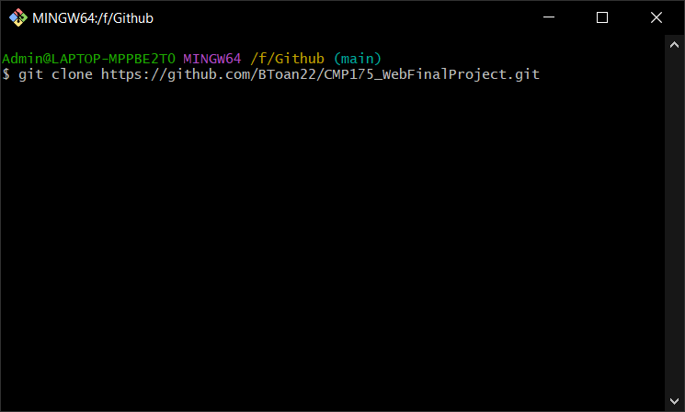
Step 1:
Using Git to clone the project on GitHub with link:
https://github.com/BToan22/CMP175_WebFinalProject.git

Slide 4
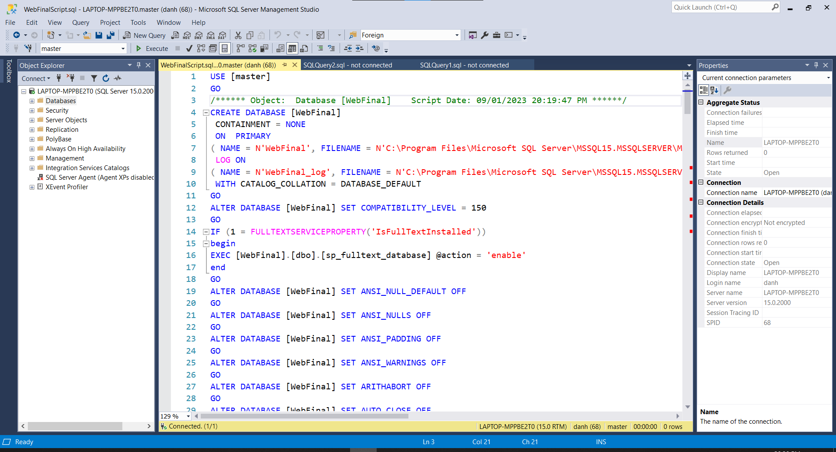
Step 2:
Using the WebFinalScript file and excute it on Microsoft SQLServer.

Slide 5
Step 3:
Delete table dbo.Provinces and right click on database WebFinal →Task → Import Data and import file Provinces.xls.
Step 4:
Open folder WebFinal and double click file WebFinal.sln to run project on Visual Studio.

Slide 6
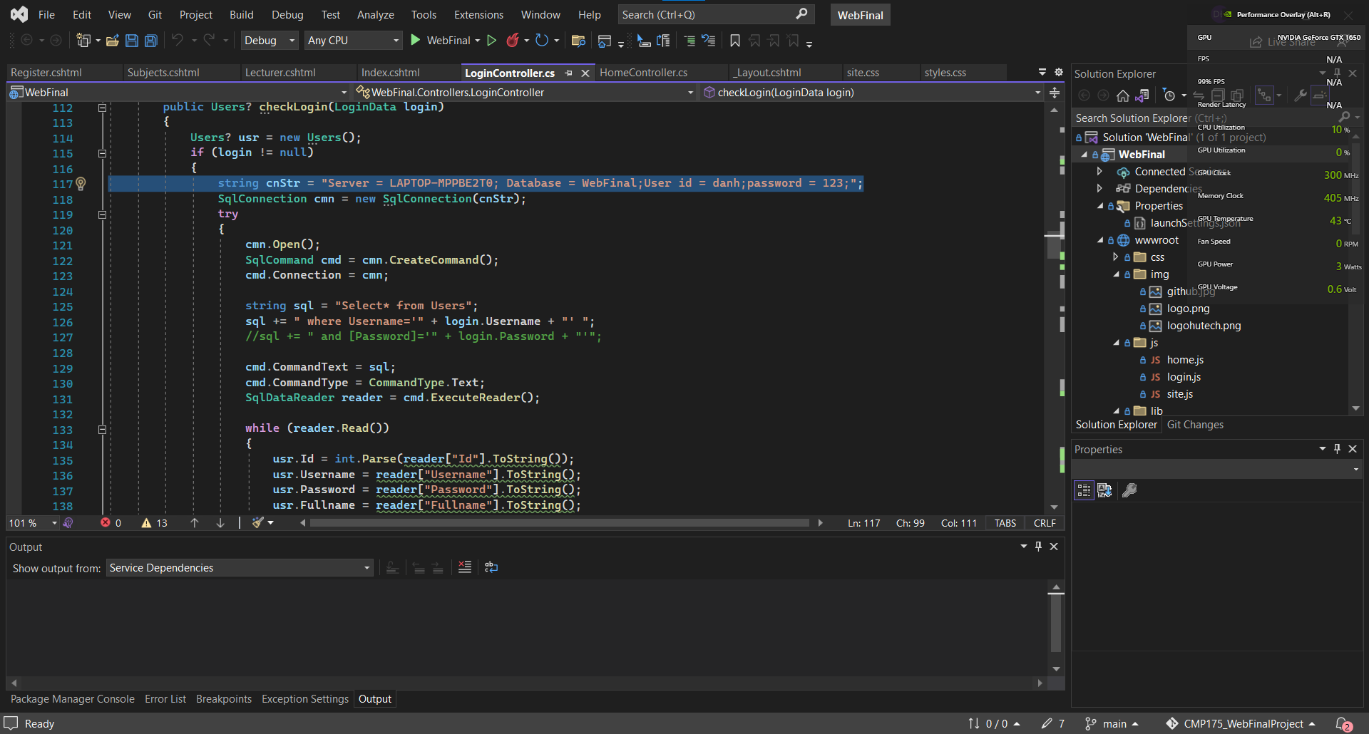
Step 5:
Open LoginController in project.
In line 117 change the Server equal to your server name in Microsoft SQLServer.
Change user id and password equal the user login you have.

Slide 7
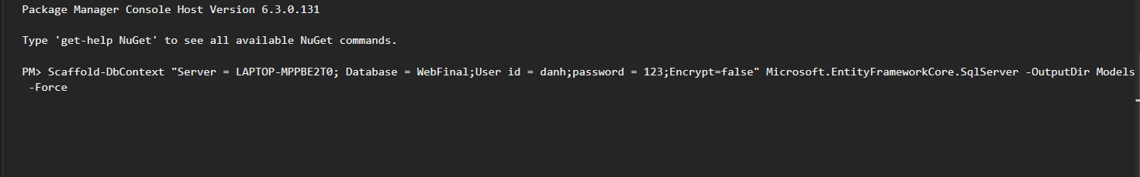
Step 6:Click Tools → NuGet Package Manager → Package Manager Console
Paste this into console:
Scaffold-DbContext "Server = LAPTOP-MPPBE2T0; Database = WebFinal;User id = danh;password = 123;Encrypt=false" Microsoft.EntityFrameworkCore.SqlServer -OutputDir Models -Force
Replace the Server, user id and password you have in Microsoft SQLServer

Slide 8
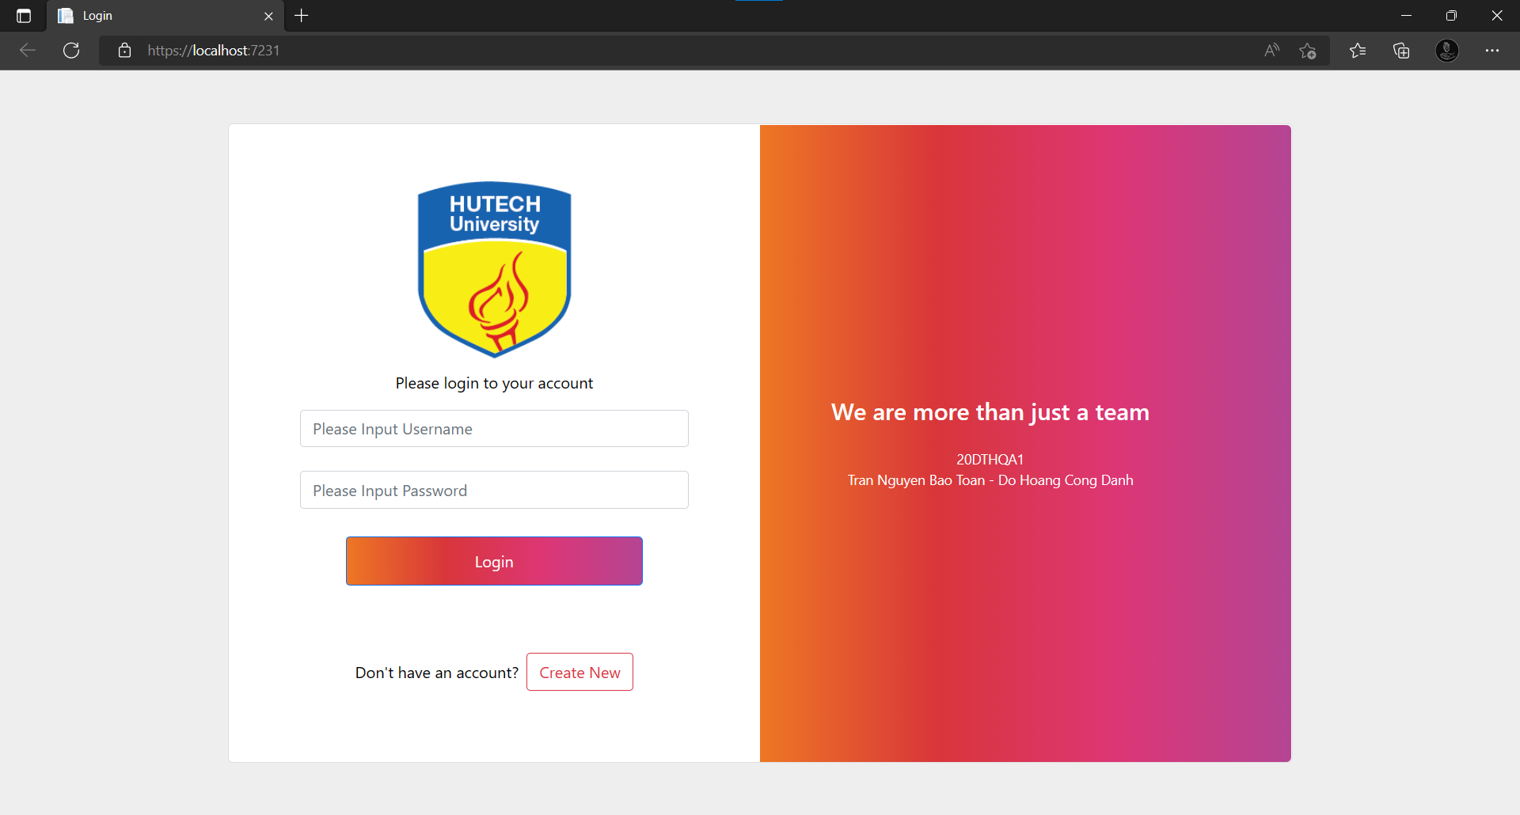
Step 7:
Excute the WebFinal project

Slide 9
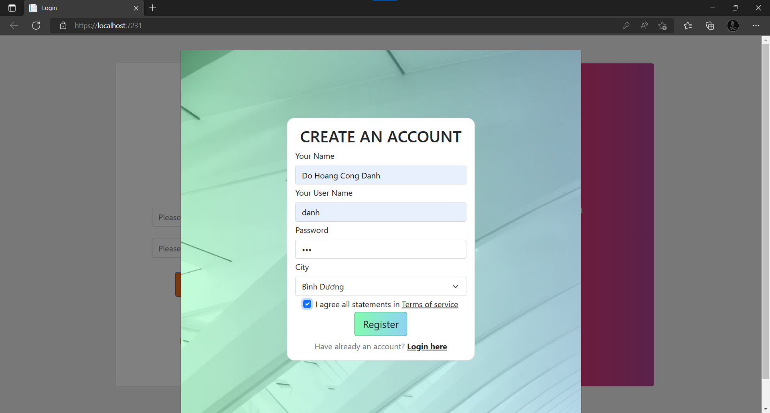
Step 8:
Click Create New to Register and click Register

Slide 10
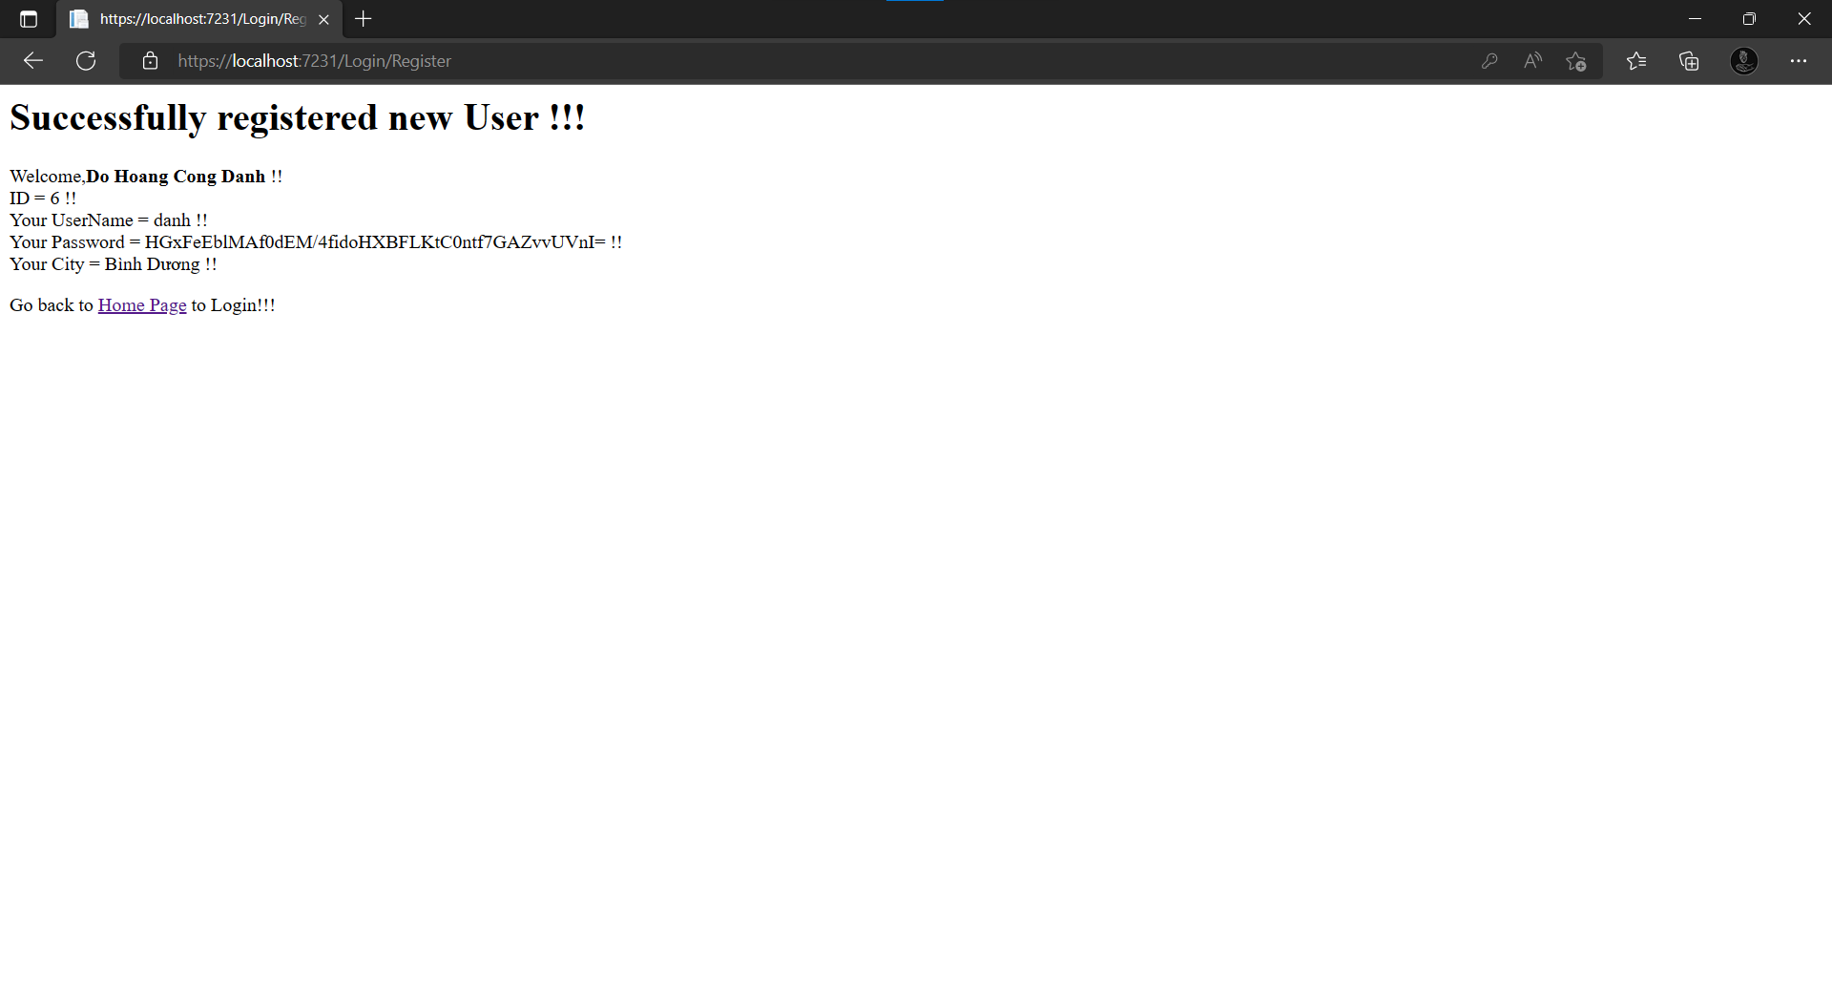
Step 9:
Click Home Page to return the login form and fill your user name and password

Slide 11

LIKE THIS and click login

Slide 12
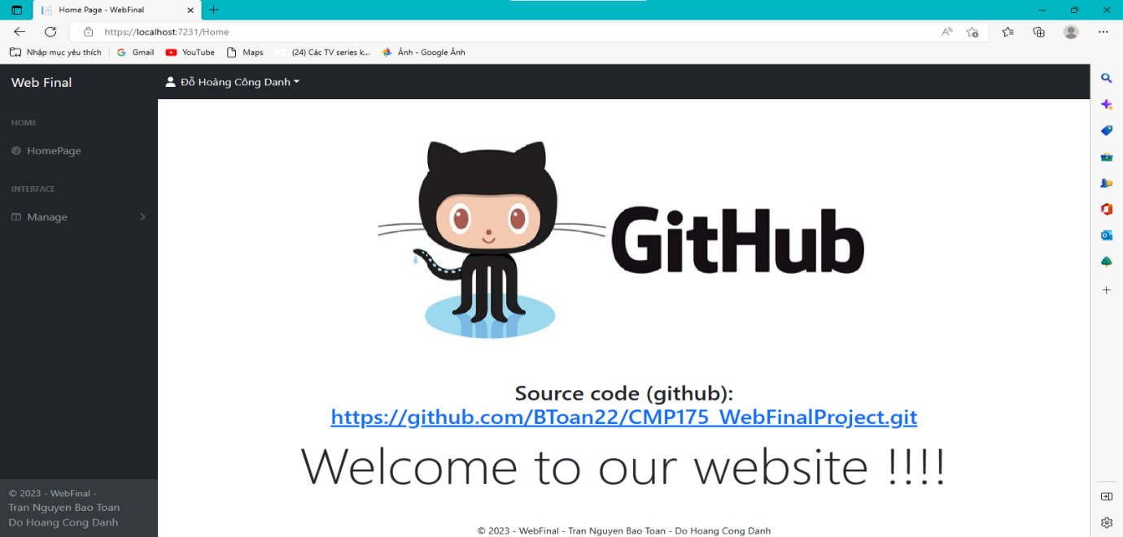
Home Page

Slide 13

FEATURE

Slide 14
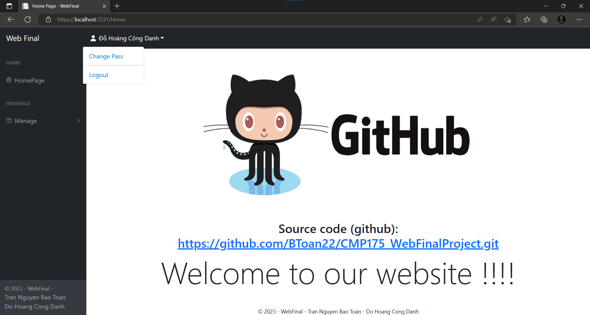
-Click on fullname to open two feature: Change pass and log out

Slide 15
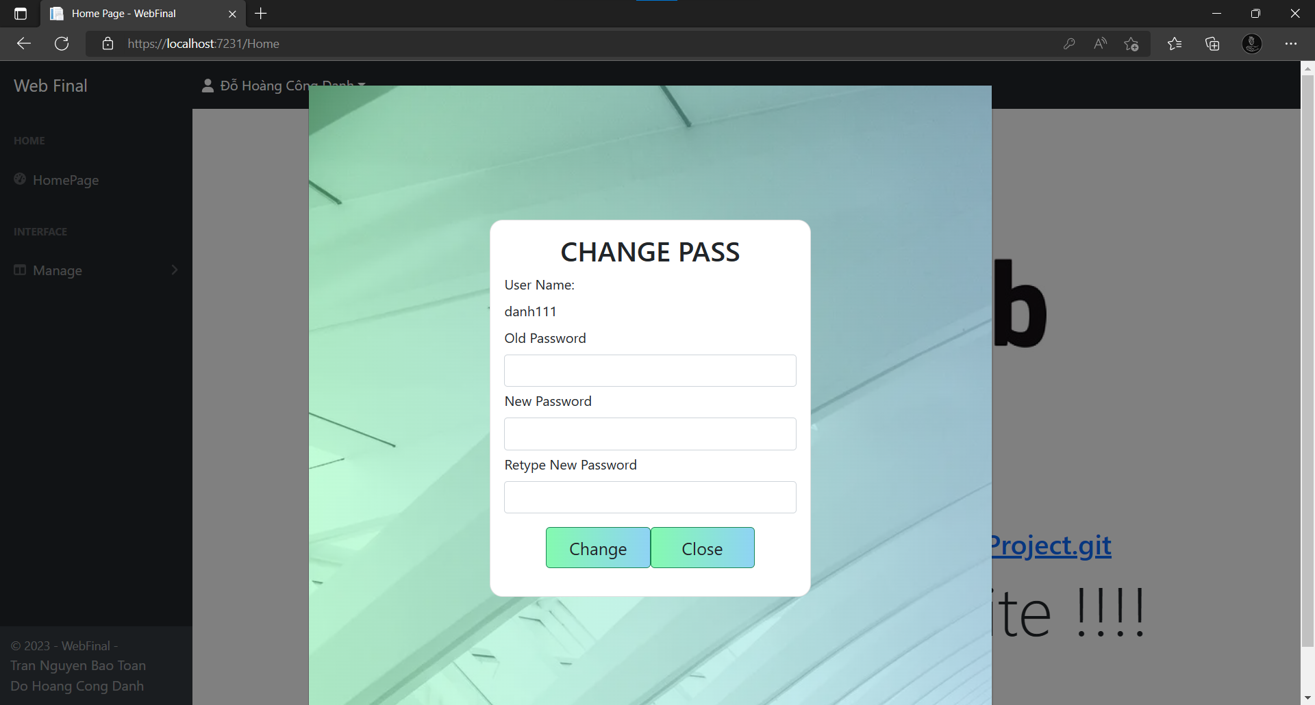
Change Pass form

Slide 16
Change Pass form

Slide 17

Click Manage → Student/Lecturer/Subject to open Student/Lecturer/Subject Manage form

Slide 18
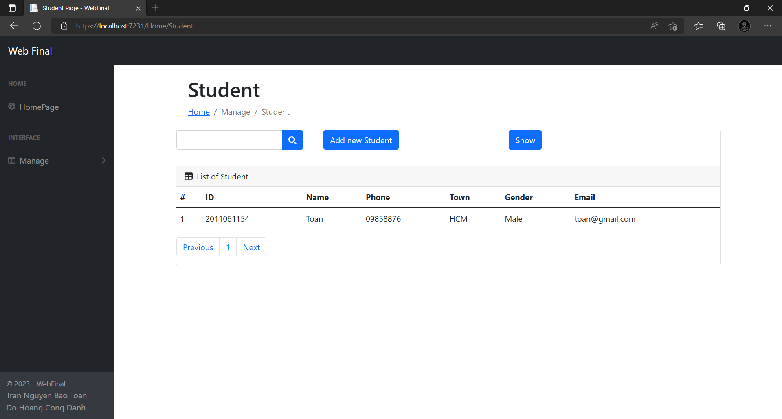
STUDENT FORM

Slide 19
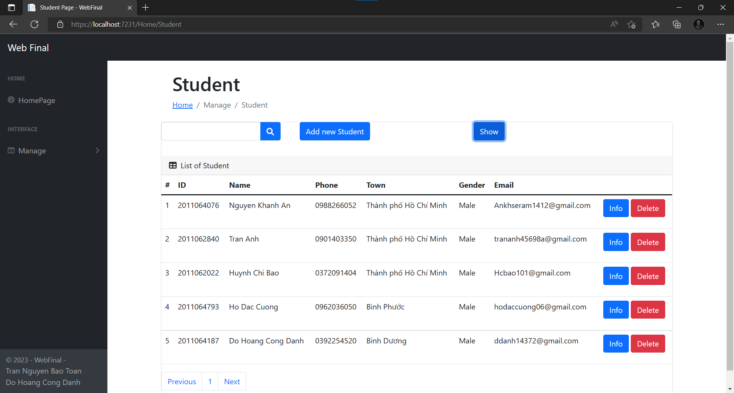
Click show to show all data in database

Slide 20
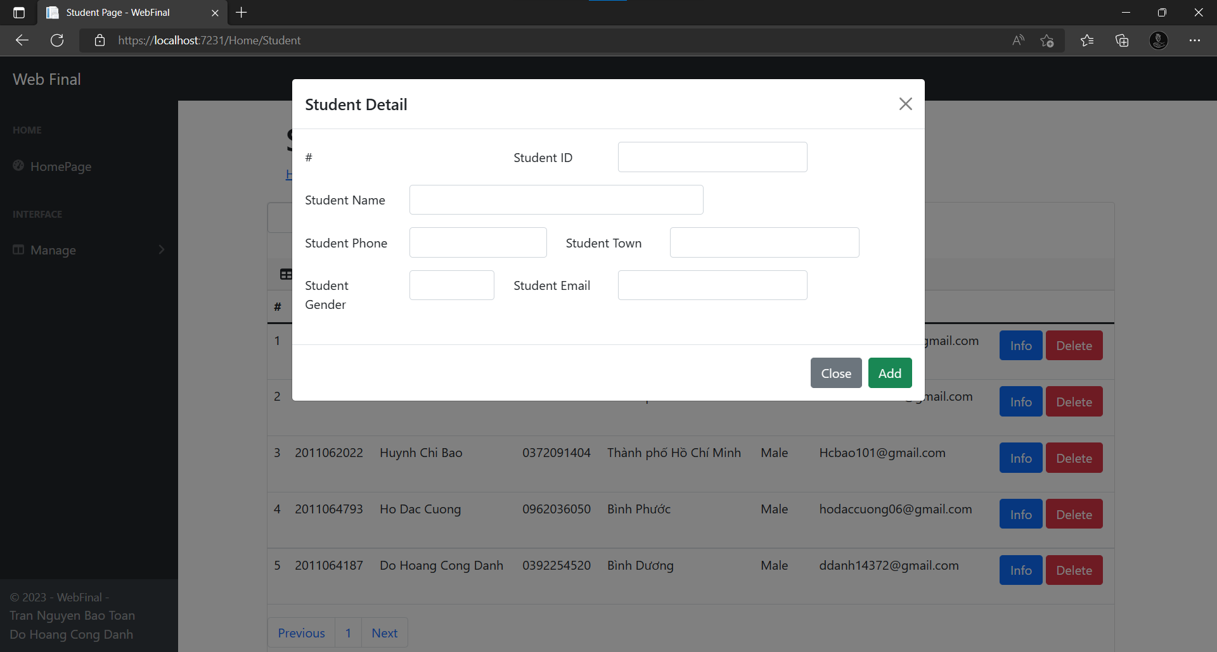
Click Add new Student to Add new object

Slide 21
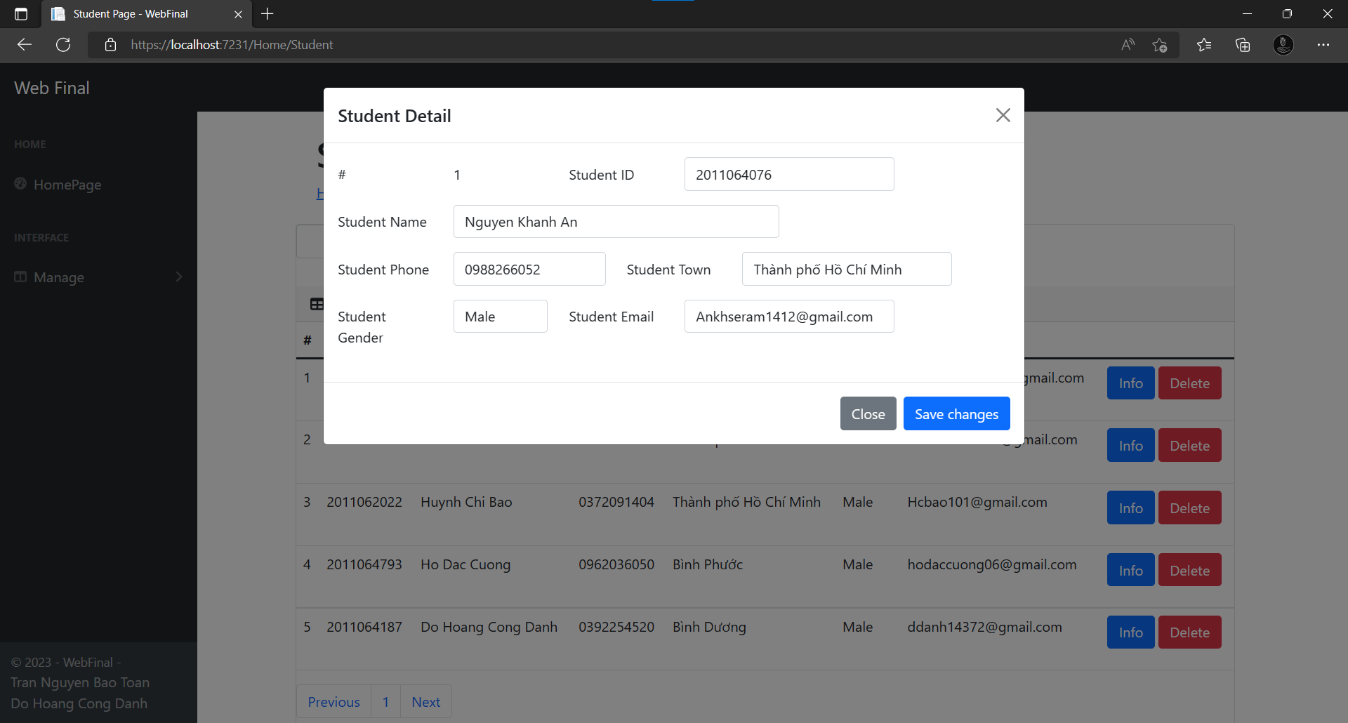
Click info to open Details of this student
You can change info and click save change to apply change

Slide 22
Click Delete to delete the object you want

Slide 23
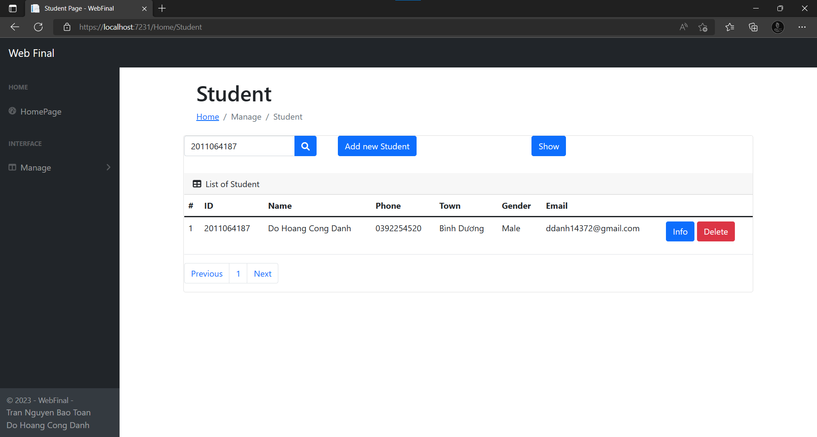
You can search by student id

Slide 24
You can search by student id

Slide 25
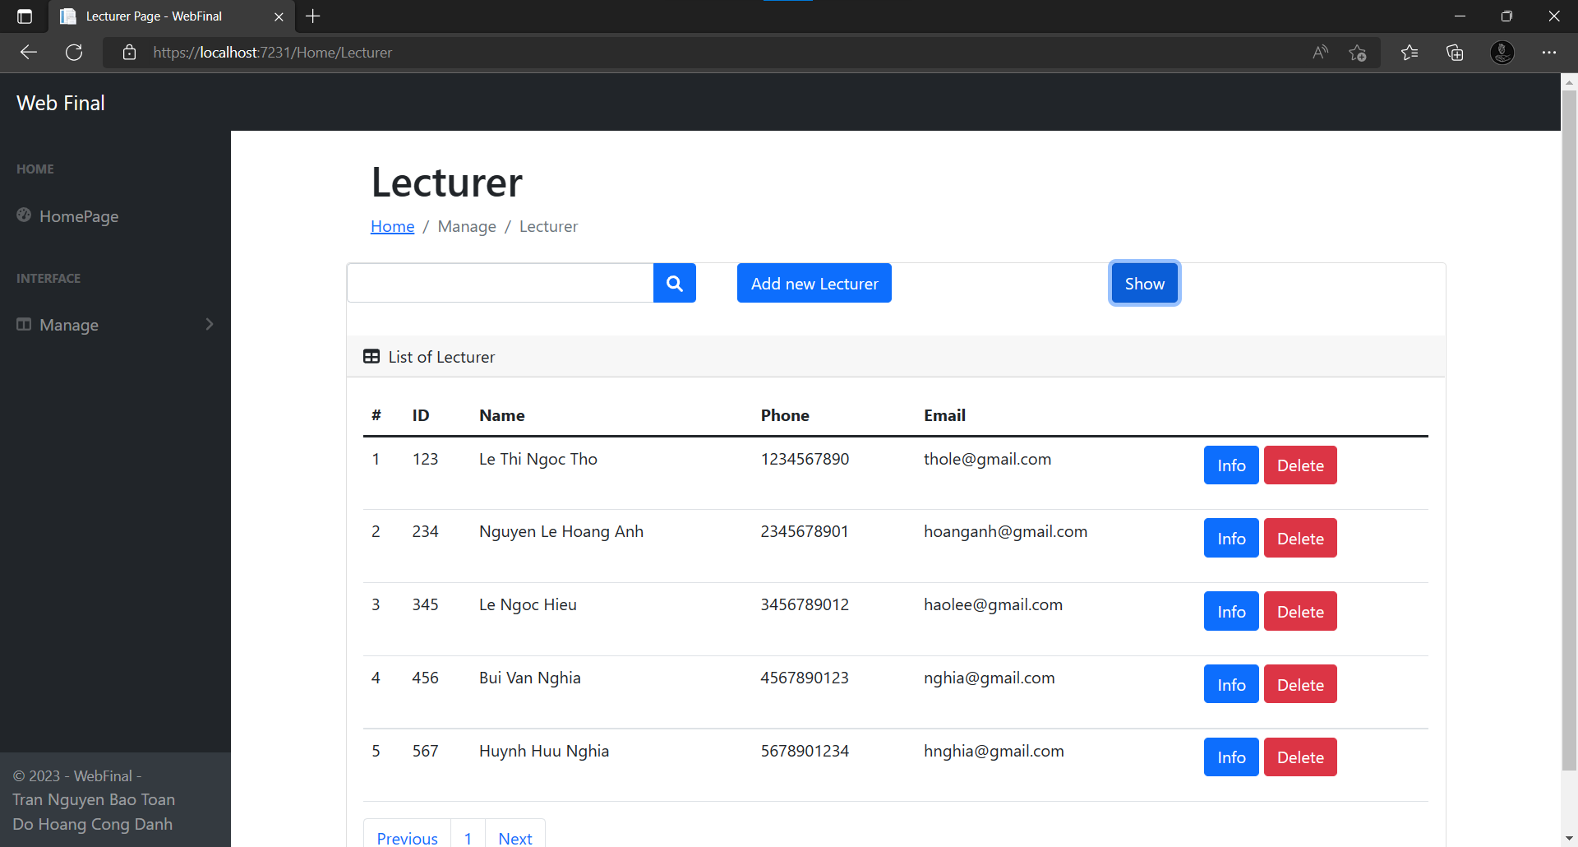

LECTURER FORM
Click show to show all data from database

Slide 26
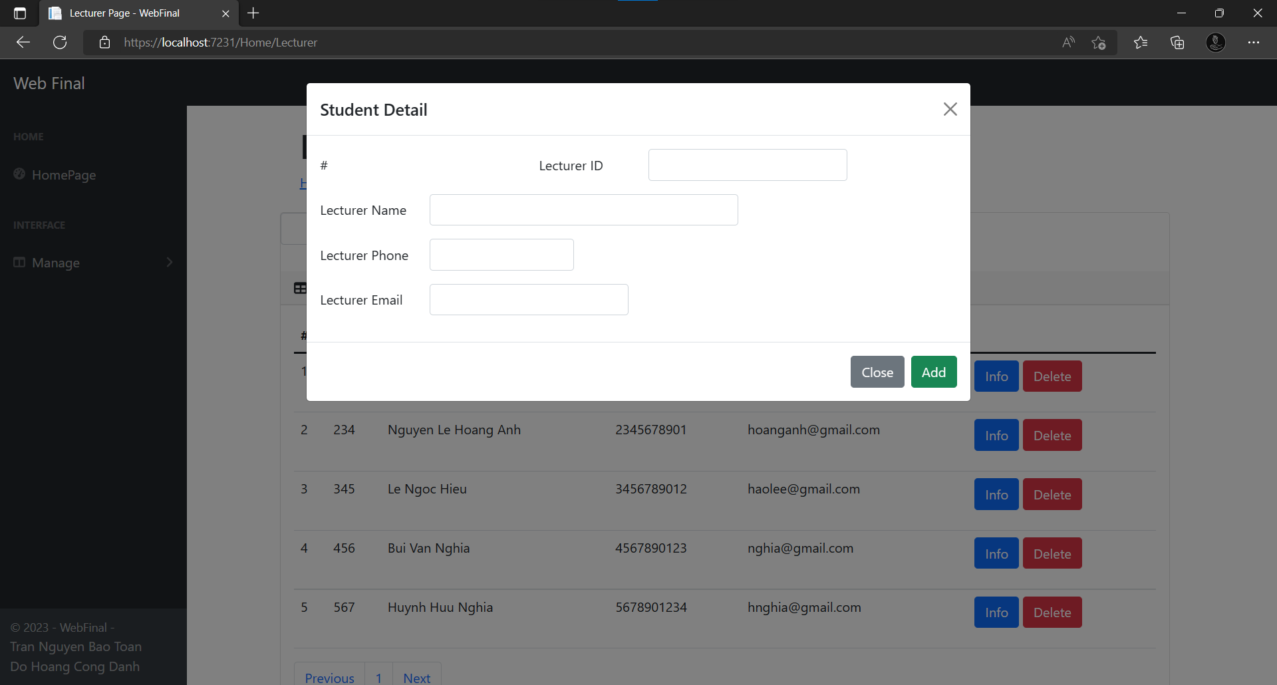
Click add new Lecturer to add new Lecturer object

Slide 27
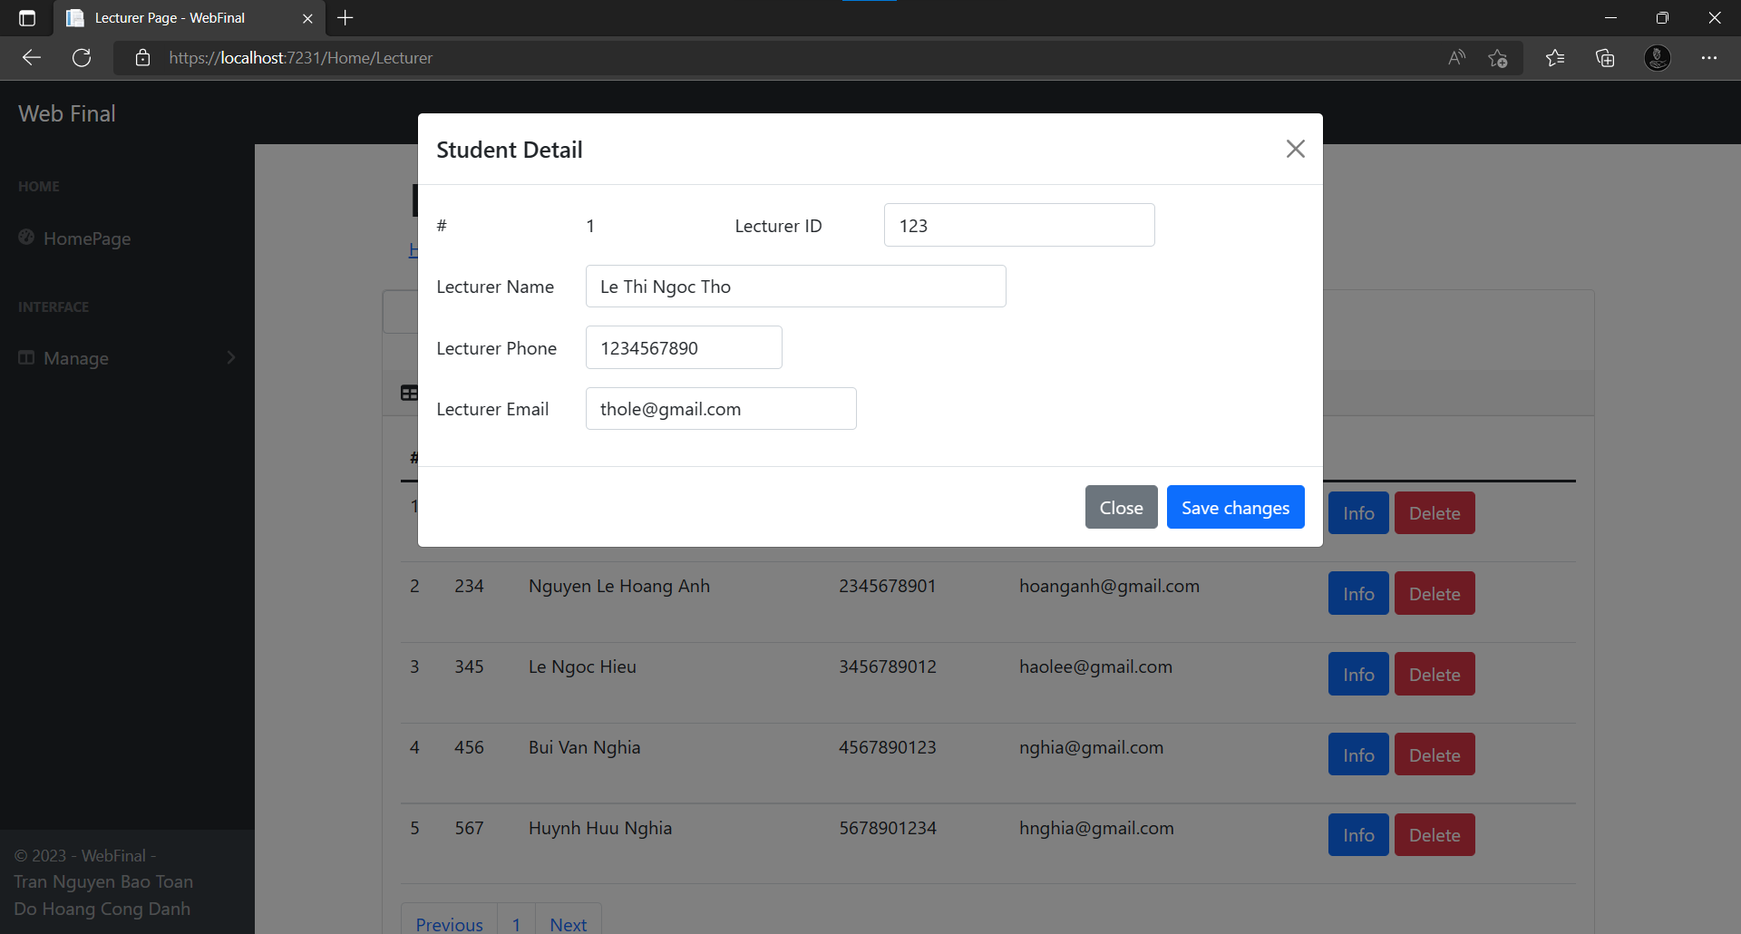
Click info to show the details of Lecturer and change the information.
Click Save Change to apply

Slide 28
Click Delete button to delete the Lecturer

Slide 29
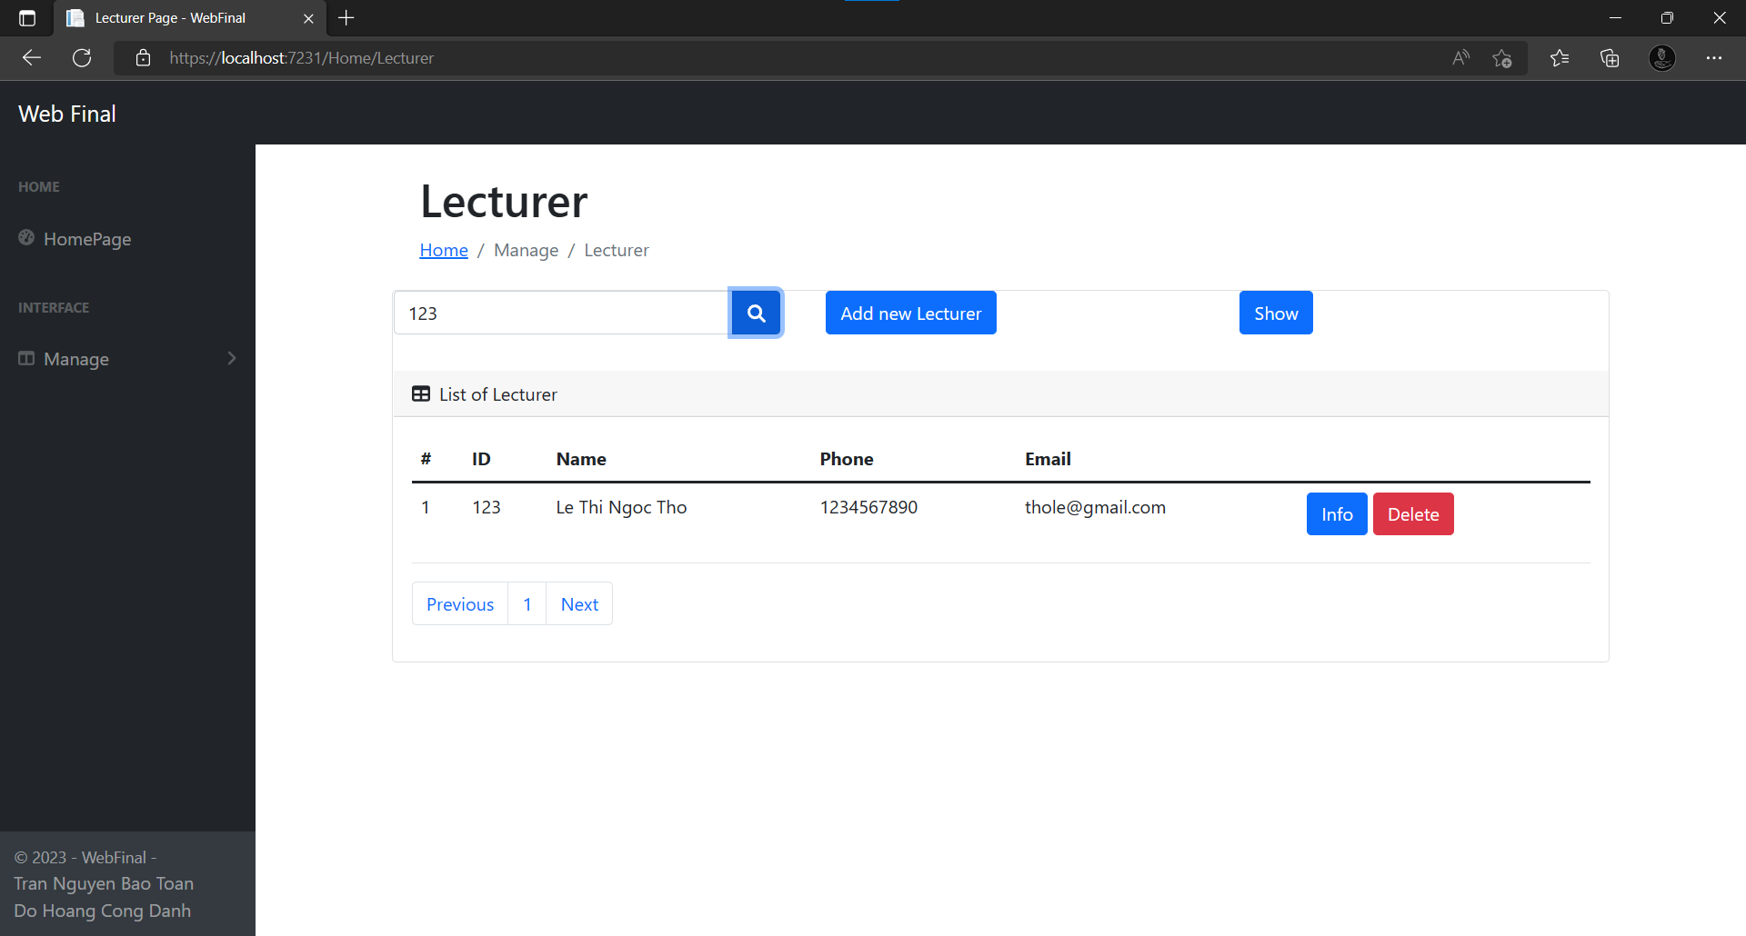
You can search the Lecturer by Lecturer ID

Slide 30
You can search the Lecturer by Lecturer ID

Slide 31
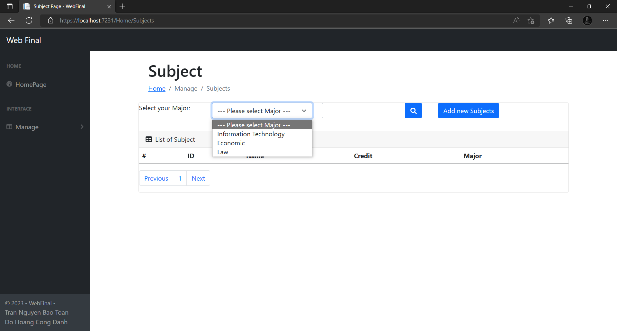

SUBJECT FORM

Slide 32
Select Major

Slide 33
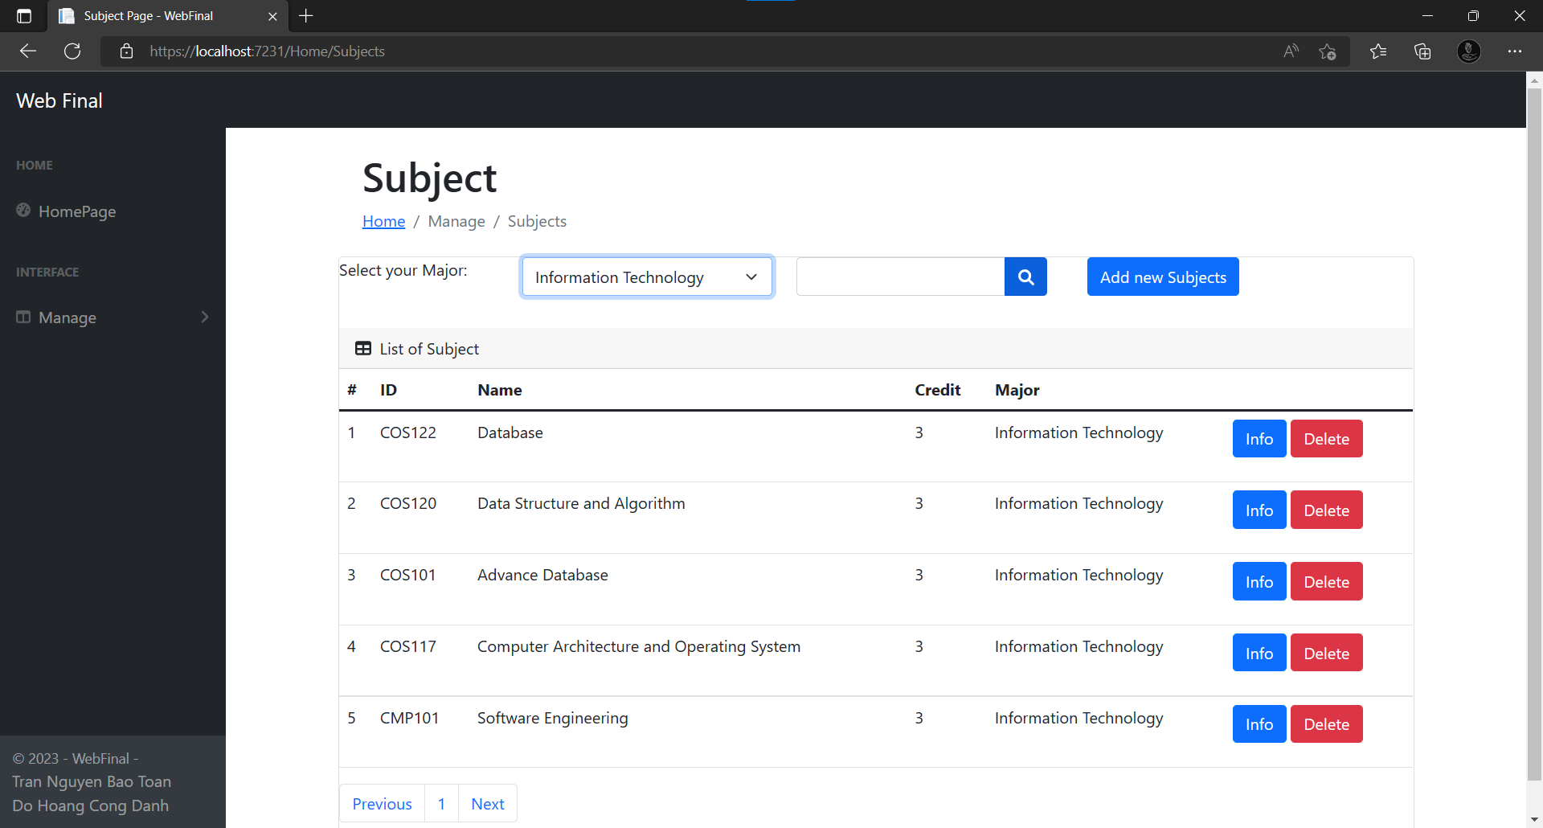
Select Major

Slide 34
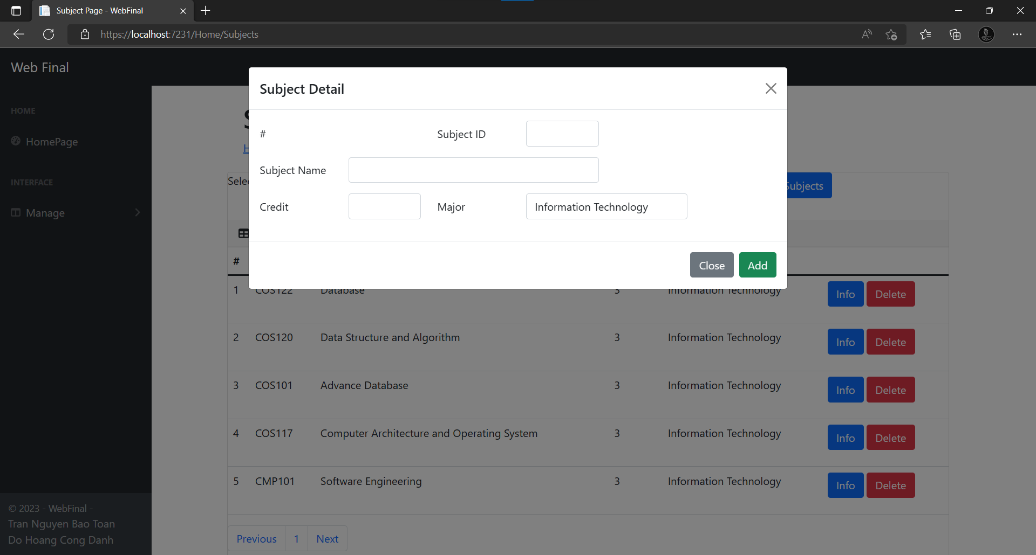
Click Add new Subject to add

Slide 35
Click info to see Subject Details
You can change the info of subject and click Save Changes to apply

Slide 36
-You can delete Subject by Delete button

Slide 37
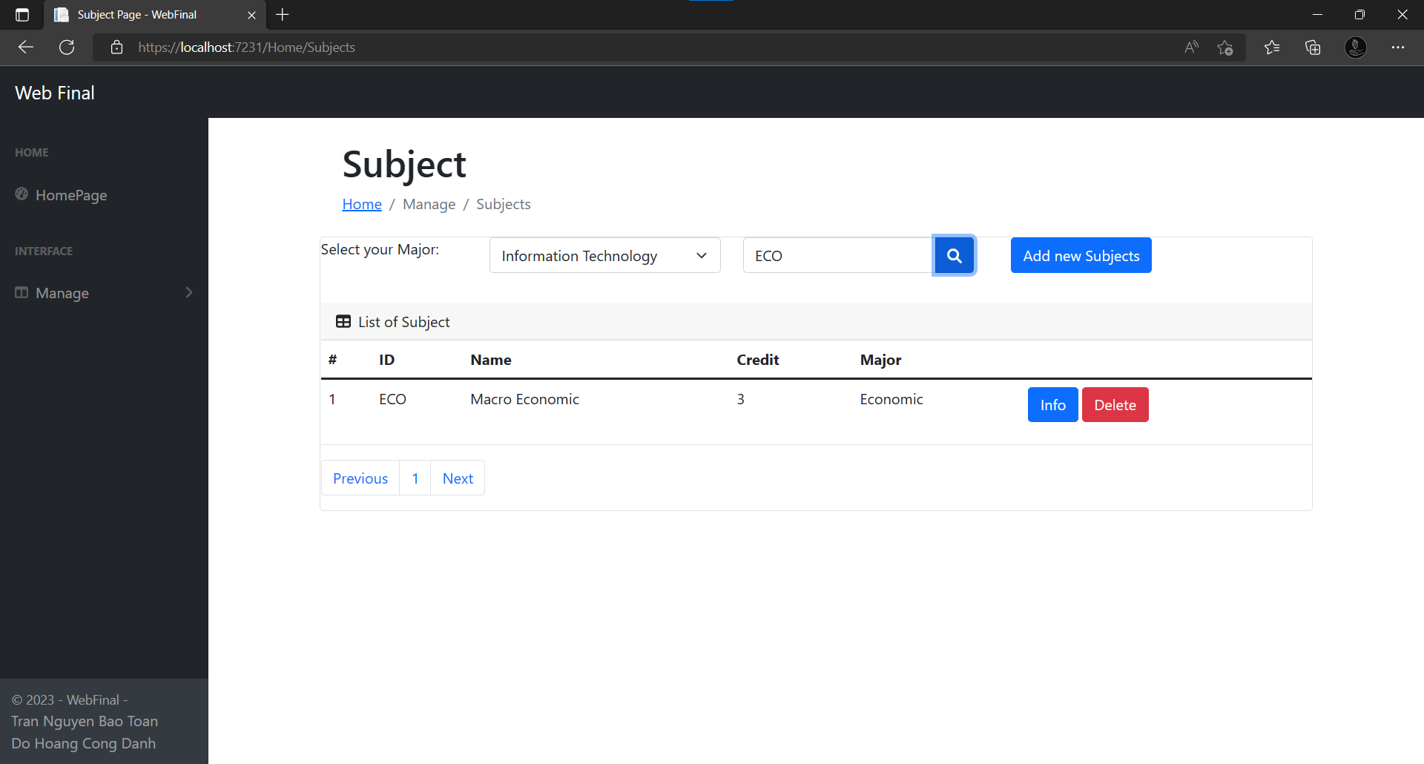
You can search Subject by Subject ID

Slide 38



01
RELATED DOCUMENT:
02

Slide 39
THANKS FOR WATCHING

